Slide 1
Analysis, Matching, and Prediction of Data with Time or Space Characteristics according to Association Rule of Data Mining
Wang Yu, Jiang Miinyu, Shao Jialin, Zhang Hongbin, Zhang Pengyu
Fan Gongxiu Hornors College, Beijing University of Technology
Mentor: Chen Juncheng

Slide 2
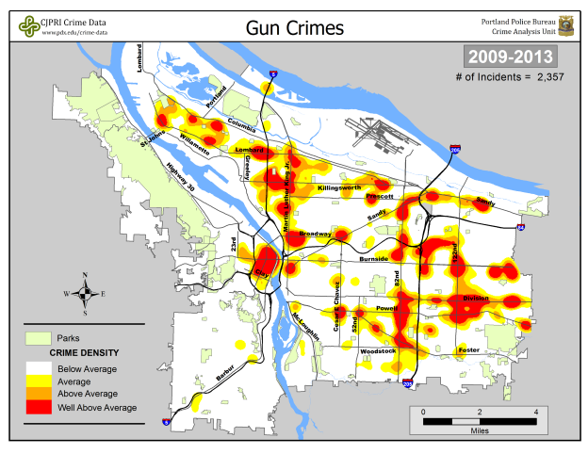

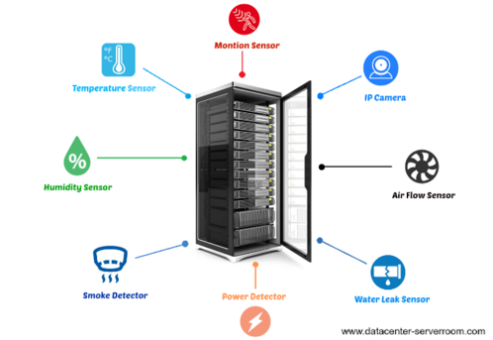
Spatiotemporal = Spatial + Temporal
Mobile Application
Crime Analysis
Environmental Monitoring
Dynamic Model
Static Model
[1] https://phys.org/news/2017-11-uber-ipo-ceo.html
[2] https://www.pdx.edu/crime-data/hotspot-past-5-years-11
[3] http://banbenpu.com/picture/server-room-environmental-monitoring-systems-home-design-great-unique-on-server-room-environmental-monitoring-systems-house-decorating/

Slide 3
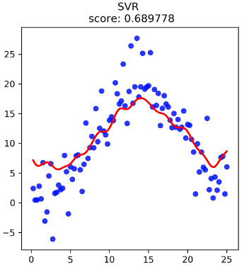
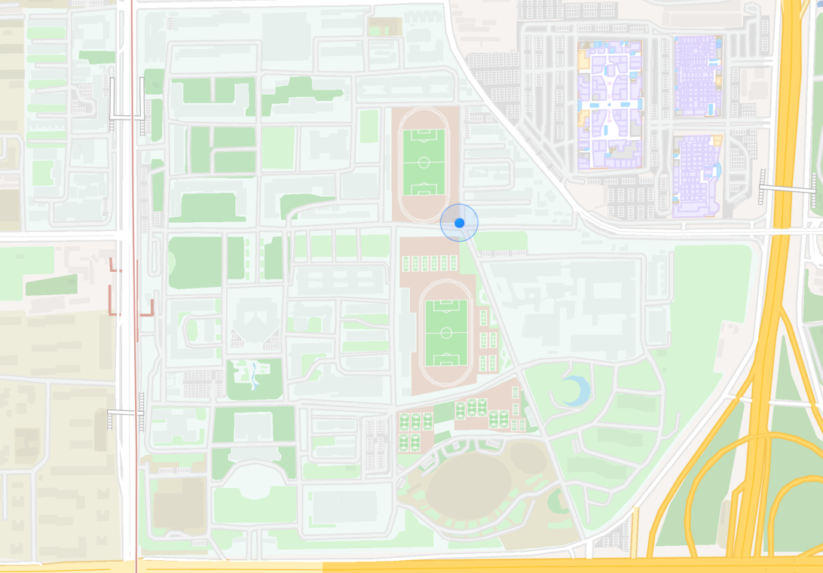

Application Scene
Sensor
Static Model
Continuous Temperature
[1] http://map.baidu.com

Slide 4
Key Problem
How to build up index for static model?
How to realize continuous query?

Slide 5




Existing INDEX – Rectangle Tree (R Tree)
Identifier = Time
Divide Space = Index
Low query efficiency in static model
Sensor
[1] http://map.baidu.com

Slide 6
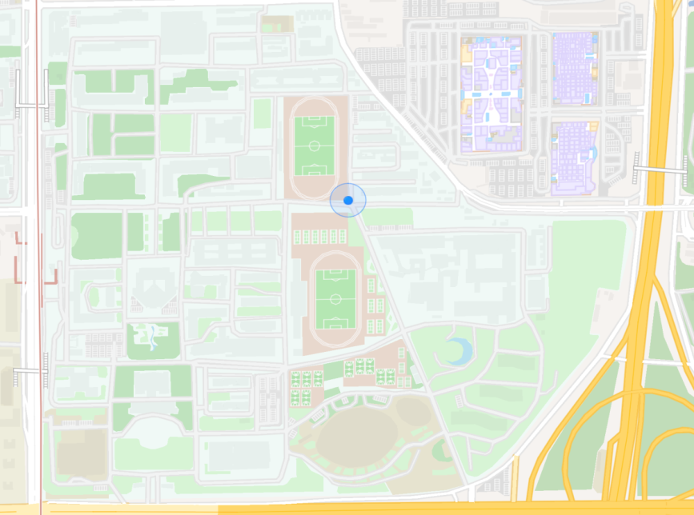
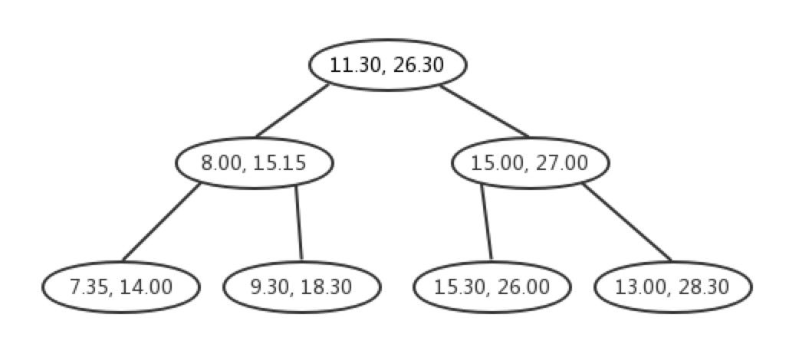

Our Solution -- K-Dimensional Tree (KD Tree)
Odd Layer
Even Layer
Dichotomy
Sensor
Identifier = SensorID (space)
Divide Time & Temperature = Index
[1] http://map.baidu.com

Slide 7


Tree Comparison
Lower dimensionality of space characteristic
Higher query efficiency
Sensor
Sensor
[1] http://map.baidu.com
[2] http://map.baidu.com

Slide 8
Query
Moment & Spot
Period & Spot
Moment & Area
Period & Area
Can’t realize continuous query

Slide 9
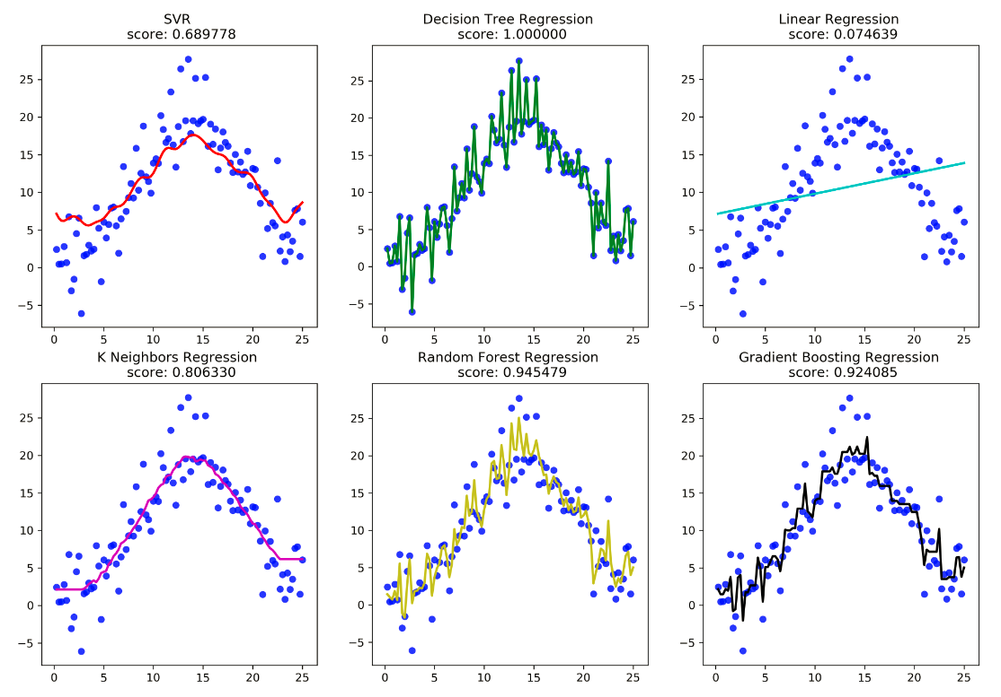
Our Solution -- Machine Learning
Fitting discrete points with 6 machine learning methods.
Using the evaluation score to choose the most suitable method.
Figure 1 Temperature in a spell at particular location

Slide 10
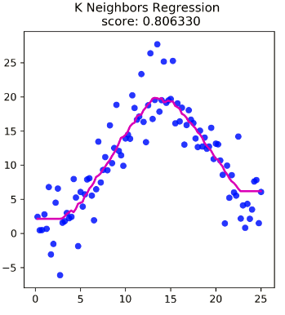
Query B -- Temperature in a Period at a Spot
Continuous query result :
Support Vector Machine Regression
temperature
temperature
time
time
Figure 2 Support Vector Machine Regression
for temperature in a spell at particular location
Figure 3 K Neighbors Regression
for temperature in a spell at particular location

Slide 11
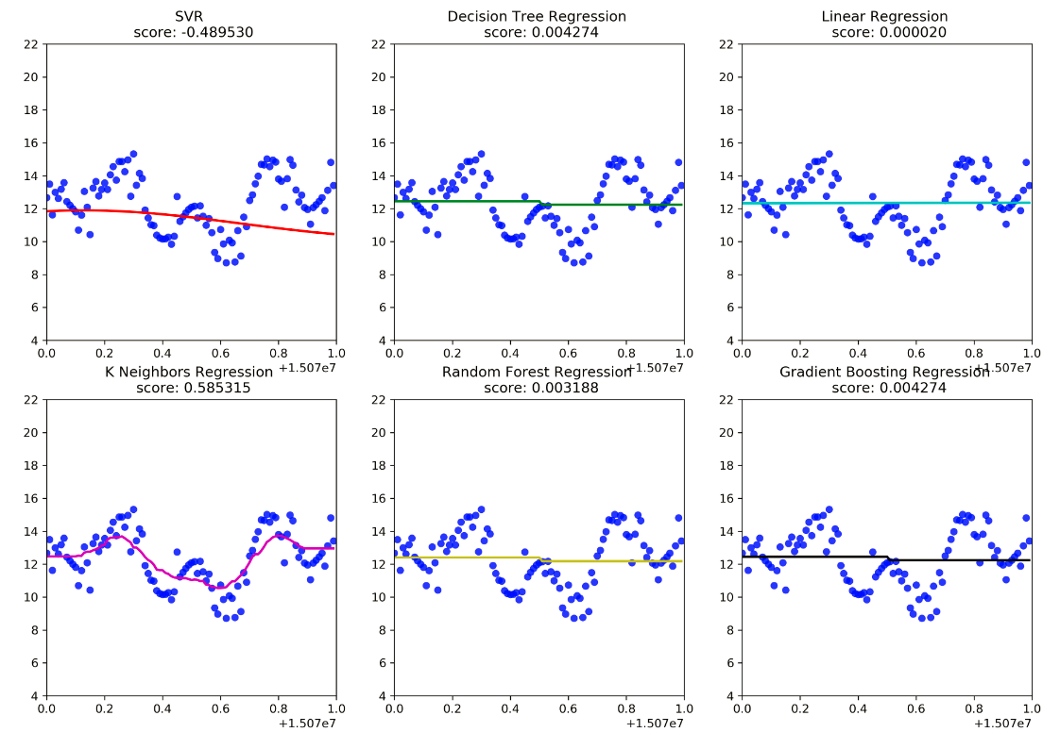
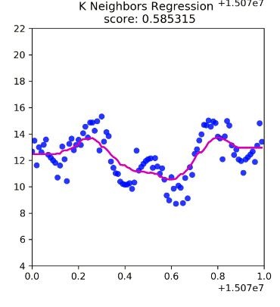
Query C -- Temperature of an Area in a Moment
Continuous query result :
temperature
id
Figure 4 K Neighbors Regression
for temperature in a particular time in areas
Figure 5 Six regression methods for temperature in a particular time in areas

Slide 12
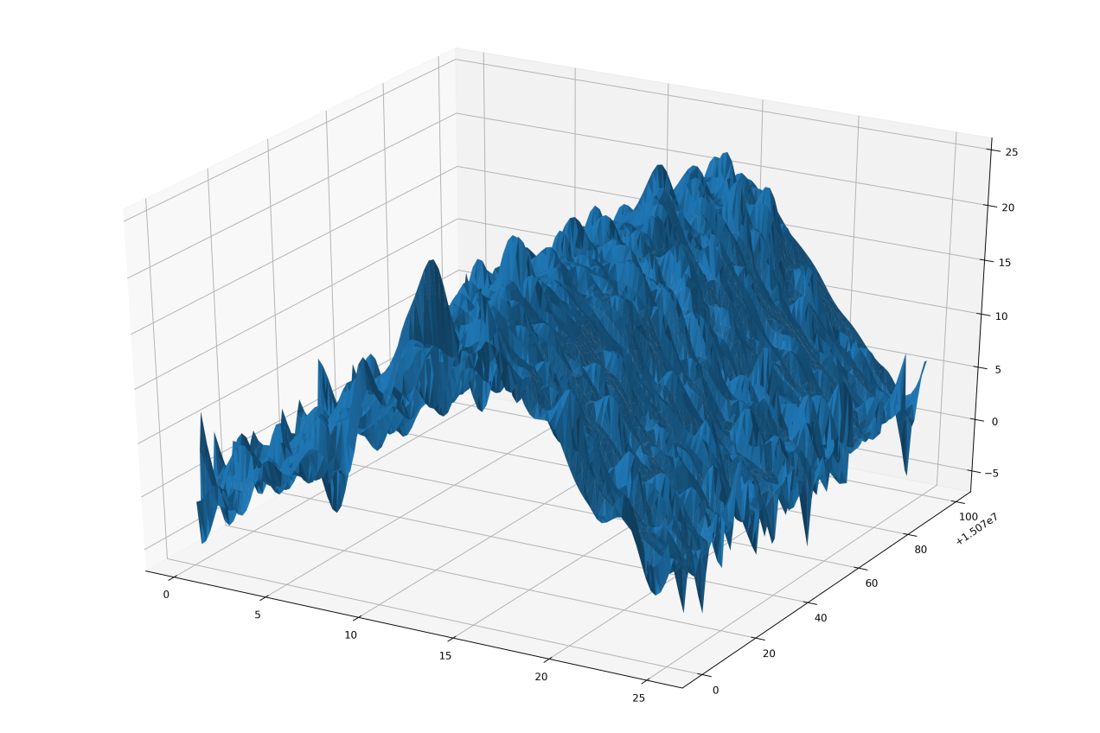
Query D -- Temperature of an Area in a Period
Continuous query result :
Support Vector Machine Regression in 3D
Fitting the 3D data set into hyper plane
Innovation
temperature
id
time
Figure 5 Support Vector Machine Regression for temperature in a spell in areas

Slide 13

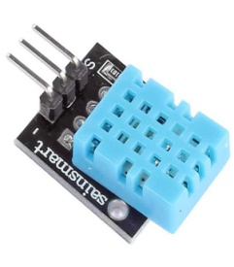

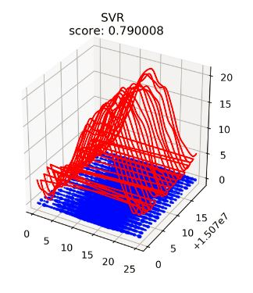
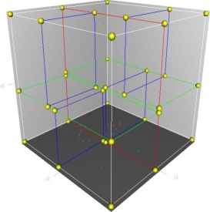
(Internet of Things) Data Analysis Platform
Sensor
TCP Module
KD Tree Module
ML Module
Temperature
Collecting
Data Transmission
&
Data Standardization
Index
Building
Continuous
Query
[1] [2] [3]http://map.baidu.com

Slide 14

Live Demonstration

Slide 15

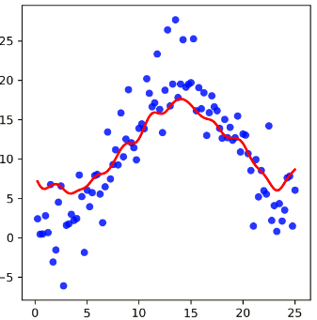
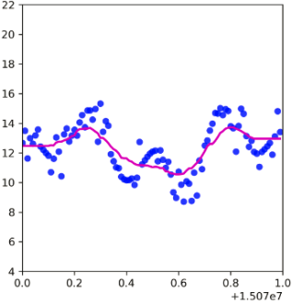

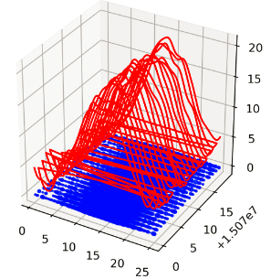

Conclusion
Index for Static Model – KD Tree
Continuous Query – Machine Learning
Sensor

Slide 16







Conclusion
Intelligent Logistics
Intelligent Agriculture
Smart Tourism
Smart City
Intelligent
Medical Treatment
Smart Transportation
[1] [2] [3] [4] [5] [6] https://images.google.com

Slide 17
Thanks for Listening

